Slide 1

Clean Architecture
The Software Way

Slide 2



John and Kevin
John Townsend
Kevin Logan
Tweets @jowtow​​
DSU Spring 2019 CSC & Math
First year at Omnitech​
Family, music, knick-knacks, arts and crafts, listening to audiobooks
Tweets @alignedDev​
Blogs @ http://www.aligneddev.net​
12+ years at Omnitech
faith, family, biking to work, guitar, eating healthy, reading and learning
http://life.omnitech-inc.com/

Slide 3

Clean Architecture By Uncle Bob Martin
Notes:
We read this book as a group at Omnitech (chance to get someone interested in working at Omnitech, but not directly).
We’ve learned a lot about these concepts and what we want to improve on.
Reading this book together and the discussions we’ve had has given us a common language. It’s shown use the importance of thinking about the structure of our applications, giving us much to think about and some ideas to move forward on.
Architecture is not handed down from on high, but learned and changed over time. There are principles that can look for to help guide us on the way. It’s really difficult.
We hope that you’ll gain form our learnings (we only have an hour) and come away with a few things you can start to apply. Maybe you’ll even decide to start a book club at your work!
We’ve all worked on difficult to change code, maybe even plagued by regression issues
What is architecture?

Slide 4

A Cautionary tale from the Book
Note: graphs removed, see Chapter 1
They started with a few devs
and had great success
Notes:
Release 1 was delivered with a few thousand and one developer. Over the 8 releases, they went from a few to 1200 (fig 1 not shown). That’s a large jump! There was success so they hired more (the numbers on the bottom of the graphs are releases).
Transition: why didn’t adding developers fix increase velocity and why did the cost skyrocket?
What went wrong?

Slide 5
Have you experienced this?
Why doesn’t adding more developers, increase productivity?
Features Developed =? Number of Programmers * Requests

Slide 6

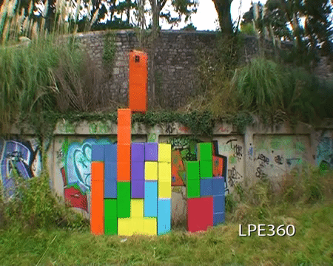
Business Requirements (Differing Points of View)
Stakeholders
Architect and Developers

Slide 7
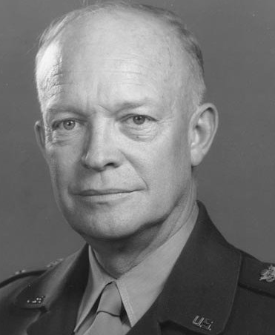
Urgency Vs. Importance (The eisenhower matrix)
 | Urgent | Not Urgent
Important | Critical Issues | Architecture
Not Important | New Features / Bugs | Twitter

Slide 8
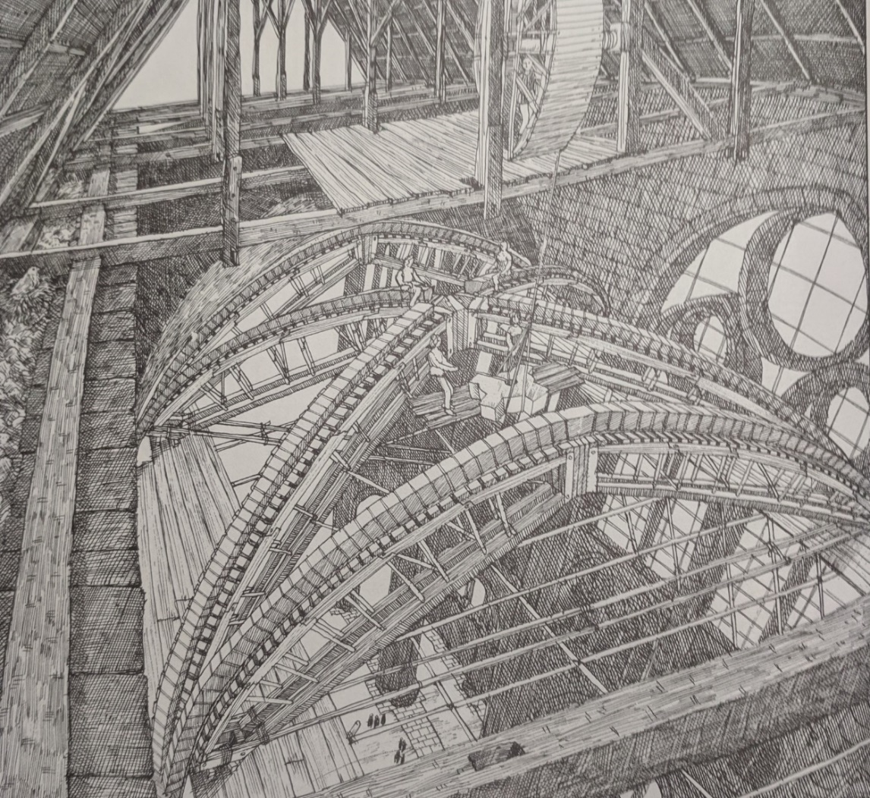
What is the most important part of your application?
Policy
“software systems are statements of policy”
Higher levels of policy are more focused on rules, and less on details
Higher level rarely changes
“Policies that change for the same reasons and at the same times, are at the same level and belong together in the same component”
From Cathedral by David Macaulay
Notes:
Open ended question
Give out some Omnitech swag
What drives it
It’s what the company would do, even if you haven’t automated your processes with software
Higher level
Doesn’t depend on anything
Changes less often (ex: banking interest rates)
No, it's policy. What makes your business money helps your cause?
What's business logic?

Slide 9
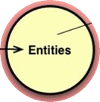
Level : Entities
Critical Business Rules + Critical Business Data
Rules that would exist in the business regardless of if the software exists
Reusable across systems
Highest level
Notes:
Example: Rules to calculate an interest rate
Example: in order to create an account at our bank, we need the customer to provide their address, SSN and phone number.
These are the center of your application, other code depends on it. These do not depend on others.
These will change less than any other part of the application
These are how your business makes or saves money
“Entities encapsulate Enterprise wide business rules. An entity can be an object with methods, or it can be a set of data structures and functions. It doesn’t matter so long as the entities could be used by many different applications in the enterprise.
If you don’t have an enterprise, and are just writing a single application, then these entities are the business objects of the application. They encapsulate the most general and high-level rules. They are the least likely to change when something external changes. For example, you would not expect these objects to be affected by a change to page navigation, or security. No operational change to any particular application should affect the entity layer.” ~ https://blog.cleancoder.com/uncle-bob/2012/08/13/the-clean-architecture.html

Slide 10
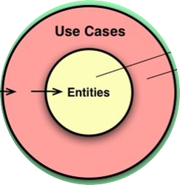
Level : Use cases
Business Rules + Application
“Control the dance of the Entities”
Notes:
Application Use Cases
Not UI specific
Example: Shopping Cart
When the user adds more then $100 in the cart
Then they will get free shipping and be notified
“The software in this layer contains application specific business rules. It encapsulates and implements all of the use cases of the system. These use cases orchestrate the flow of data to and from the entities, and direct those entities to use their enterprise wide business rules to achieve the goals of the use case.” ~
https://blog.cleancoder.com/uncle-bob/2012/08/13/the-clean-architecture.html

Slide 11
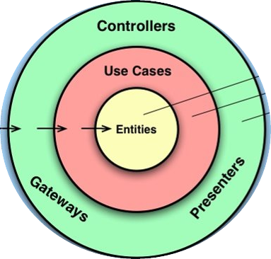
Level : Adapters
Glue, translation, conveyer belts

Slide 12
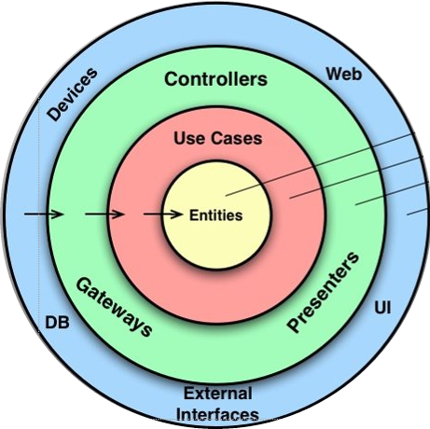
Level : Details
Frameworks, drivers, anything that is completely independent from your business logic.
More Examples:
CRM
Sharepoint
APIs
Payment Systems
Hosting: IIS, Nginx, Service Fabric, K8s
Containers
Notes:
Abstract them away

Slide 13
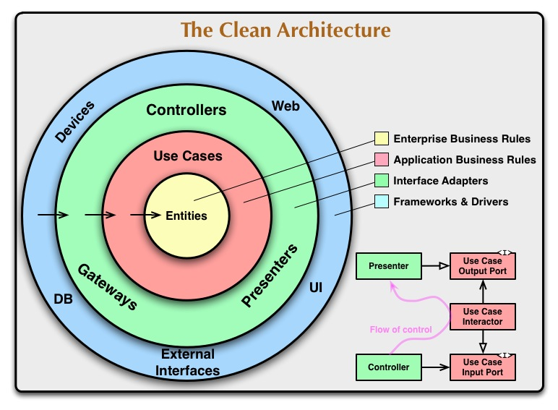
Level : Full picture
Notes:
Boundaries are firewalls from change

Slide 14
Start from the middle
Identify your policies and code to those first
Defer details for as long as possible
Keep a boundary between each layer
Notes:
Boundaries are firewalls from change

Slide 15
Start from the middle
How do we start from the middle?
What if the project is already started?
Notes:
Example:
What about already started project?
-

Slide 16
Highlights to remember
Boundaries
There are common Principles
Urgent & Important
Architecture grows and changes over time
Defer Decisions
Scream Architecture
Inversion of Control
OO is about polymorphism
SRP – one reason to change “actor”
Components
Slow and Steady
Notes:
Defer decision
Architecture grows and changes over time
Components and Boundaries
Reasons to change actors
240: SOA is not architecture. "The architecture of a system is defined by boundaries that separate high-level policy from low-level detail and follow the Dependency Rule"
OO is about polymorphism
The only way to go fast, is to go well.
Do you ever go back and clean things up? No!
“The bigger lie that developers buy into is the notion that writing messy code makes them go fast in the short term, and just slows them down in the long term” page 10 tortoise and the hare

Slide 17
Downsides
Can’t just do “it will work” solutions, have to think more and seems like more work in the short term
  Appears that turn around is slower
  The required boundaries require mapping code that devs aren’t used to
People need to know and learn the patterns
  Convincing, discussions and buy in may be difficult
  Page 321 "your best design intentions can be destroyed in a flash if you don't consider the intricacies of the time implementation strategy"
There’s a lot to know about, it can be overwhelming
The team may need new approaches (ex performance of a Sproc with business rules vs C.A. approach on a batch call)

Slide 18
Positives
Easier to change and adapt to business request
Firewall to changes
Common terminology and understanding of business rules
Patterns to follow and good coding practices.
Adapt to new technologies (details)
You don’t have to know it all in advance
Leads to good discussions, new ways to approach challenges
Tradeoffs and principles
Chapter 34 The Missing Chapter
Size, skill level of team, complexity of the solution and time/budget.

Slide 19
Resources
@ardalis: www.Weeklydevtips.com and https://github.com/ardalis/CleanArchitecture
https://jeffreypalermo.com/2013/08/onion-architecture-part-4-after-four-years/
Coding Blocks Podcast https://www.codingblocks.net/ - great discussion
Ian Cooper at NDC 2019 https://youtu.be/IAcxetnsiCQ
https://stackoverflow.com/questions/10061913/application-architecture-in-practice-uncle-bob
http://blog.vranec.com/2017/10/notes-about-clean-architecture-book.html?m=1
https://blog.cleancoder.com/uncle-bob/2012/08/13/the-clean-architecture.html
https://blog.cleancoder.com/uncle-bob/2016/01/04/ALittleArchitecture.html
https://gist.github.com/ygrenzinger/14812a56b9221c9feca0b3621518635b#targetText=Clean%20Architecture%20push%20us%20to,%2C%20toward%20higher%2Dlevel%20policies.

Slide 20
Sponsor slide

Slide 21
Questions or Comments?
Feedback is appreciated
Thank you!
John Townsend
@jowtow
Kevin Logan
@alignedDev https://www.aligneddev.net
http://life.omnitech-inc.com/

