Slide 1
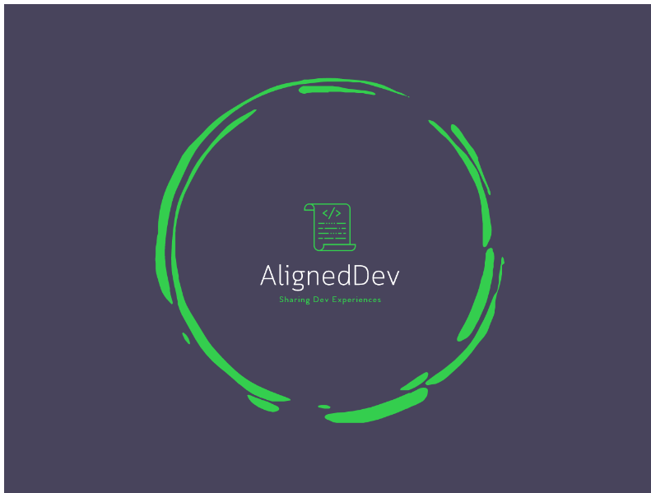
A lot of Software Development is about learning
Web Development Building Blocks
Kevin Logan – Omnitech, www.aligneddev.net, @alignedDev

Slide 2
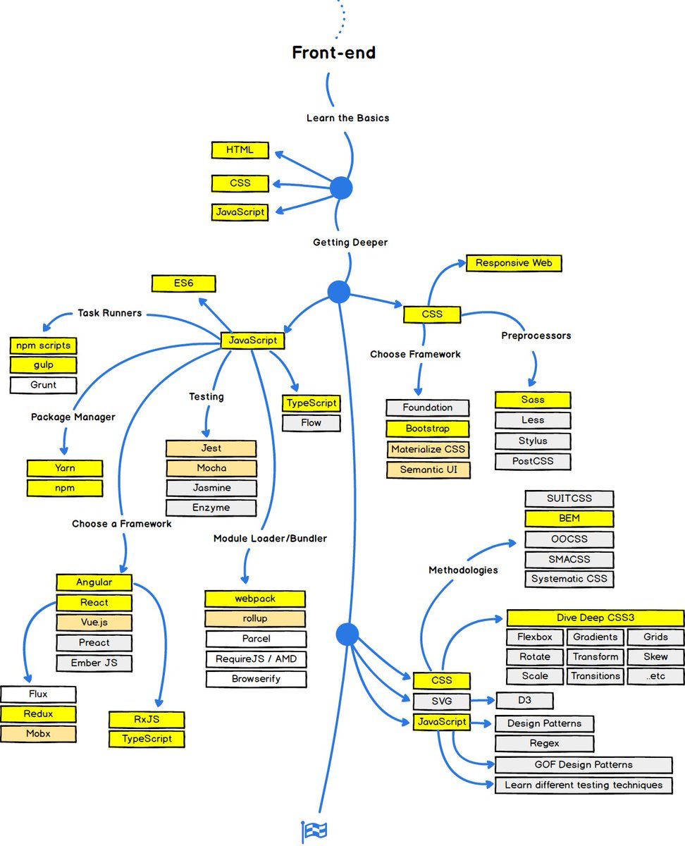

There’s a lot to learn!
Thankfully, you don’t have to know it all right away
  Over time – a little consistency adds up quick
  Having a team working together and sharing information is essential
https://twitter.com/simona_cotin/status/950747684763189249

Slide 3
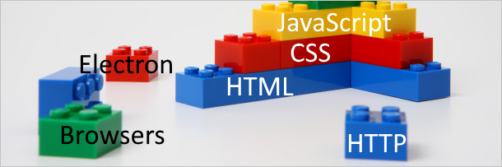
Web Development Building Blocks
HTML (HyperText Mark-up Language)
  Created in 1989 to “to organize and pool together information”
  The DOM (Document Object Model) has come a long ways
  HTML5 in 2014 with improvements
CSS (Cascading Style Sheets)
  Introduced in 1994
JavaScript
  Created by Brendan Eich and release with Netscape Navigator 2.0 in September 1995
  Has improved a lot in the last few years (ES6/EcmaScript 2016)
  W3c specs for every year going farther

Slide 4
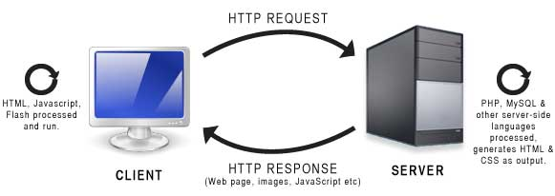
Server Side
What is Server Side?
Asp.Net Core MVC
PHP
Java Frameworks
NodeJs
  Can even pre-render client side code on the server
API – using HTTP to GET, POST, PUT and Delete
  REST
  OpenAPI
  GraphQL

Slide 5
Client Side
HTML, CSS, JavaScript
Browsers, Applications
Makes an HTTP request to the client
TypeScript
  Typed JavaScript that is complied to JavaScript
  Very helpful for development
NPM with Node
  Bring in open source and other modules to use
Dev tools: Grunt/Gulp/WebPack/Parcel…
  Run NodeJs scripts to package, minimize, combine, run tests using KarmaJs, etc.

Slide 6
Native or Web?
We have a lot of options to create apps with iOs, Android native code, UWP or Xamarin or web technologies?
  It depends.
  Pros and Cons
The lines are blurring with Progressive Web App (PWA) technology, faster JavaScript parsing engines.
Angular has Ionic, React has React Native
ElectronJs is an application shell that runs on any OS (VS Code, Slack, SQL Operations Management are examples)

Slide 7
Innovation
Web Components
Web Assembly
  Blazor “An experimental web UI framework using C#/Razor and HTML, running in the browser via WebAssembly”
WebGL demos at https://experiments.withgoogle.com/chrome?tag=WebGL
You can do cool things in a browser with WebGl
  https://www.ageofascent.com/

Slide 8
System Thinking
Automated Testing
Patterns
System Thinking
Clean Code
Clean Architecture and Design
Communication and working with a team
agility
Balancing priorities
Recording decisions
Documentation
Focus
“Improving daily work is more important then daily work”

Slide 9
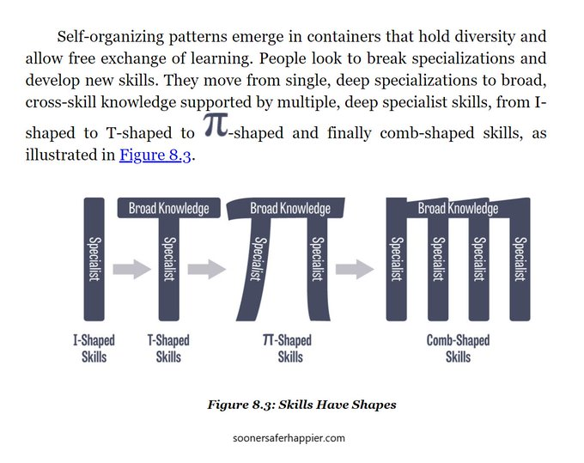
I Shaped Skills
https://twitter.com/jonsmart/status/1455151901775994885 from Jon Smart

Slide 10
Lower your time preference
Think longer term
  https://www.aligneddev.net/blog/2022/time-preference/
sowing and reaping
  https://www.aligneddev.net/blog/2019/principles-of-sowing-and-reaping/

Slide 11
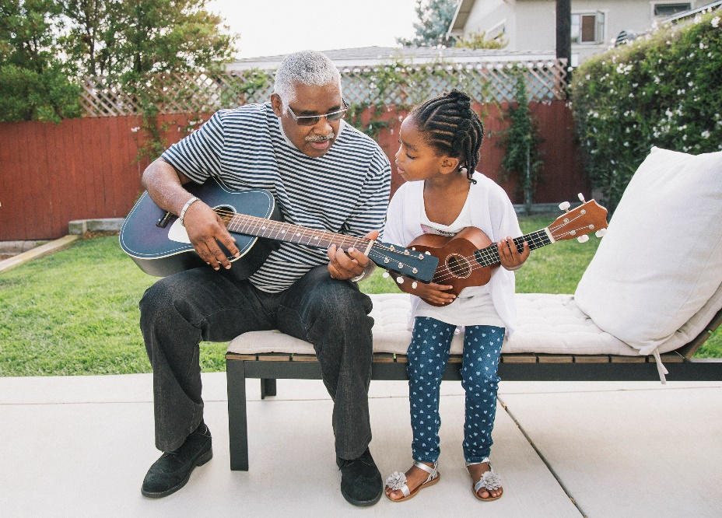
Share what you learn

Slide 12
Questions?
What are some next steps?
  Don’t be overwhelmed, think of it as opportunity
    Feels a bit like drinking from a fire hose, doesn’t it? https://imgur.com/gallery/w1X4f3j
  Keep learning and investigating, then share that with others
  Visit my blog http://www.aligneddev.net for the article with more links that I referenced here.
  "Reading 1 hour per day in your chosen field will make you an international expert in 7 years.“ - http://www.robertbrewer.org/surprising-book-facts-infographic/
@AlignedDev

